Slide 1
PRINCIPLES OF ECONOMICS
Salimah Musharrif
FPEC 101 – LECTURE 5 Unit 1

Slide 2
Elasticity

Slide 3
Outline
Elasticity of Supply
Income Elasticity
Cross Elasticity

Slide 4
PRICE ELASTICITY OF SUPPLY
When price ↑, what happens to Supply?
Supply Increases
BUT!
How much does Supply Increase?
Eg:
If price rises by 10%
The supply will increase
  By more than 10%? Or
  By less than 10%?

Slide 5
Price Elasticity of Supply
“A responsive change in supply with a change in the price is called Price Elasticity of Supply (PES)”
If a small change in price, produce a bigger change in supply → Supply is elastic.
If a large change in price, produce a small change in supply → Supply is inelastic.

Slide 6
PES - Formula
PES =
% change in quantity Supplied
% change in price
%△ Q
PES =
%△ P
PES is always Positive

Slide 7
PES Formula, Calculation, Interpretation
P | Qs
3 | 10
5 | 12
Q2-Q1/Q1
P2-P1/P1
12-10 / 10 = 2/10 = 0.2 = 0.3 <1 Relatively inelastic
5-3 / 3 2/3 0.67
0.3 x 100= 33%

Slide 8
Elastic Supply
This means that a change in price brings about a more than proportionate change in quantity supplied.
E>1
Price (£)
S
10
7
S
5
12
Quantity Supplied

Slide 9
Inelastic Supply
This means that a change in price brings about a less than proportionate change in quantity supplied
E<1
Price (£)
S
10
5
S
5
7
Quantity Supplied

Slide 10
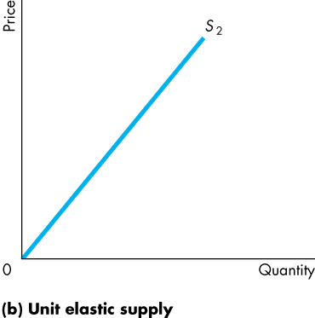
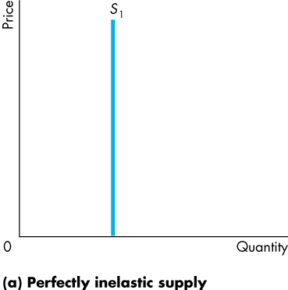
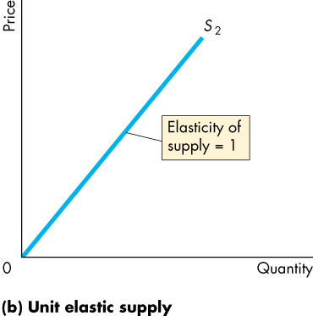
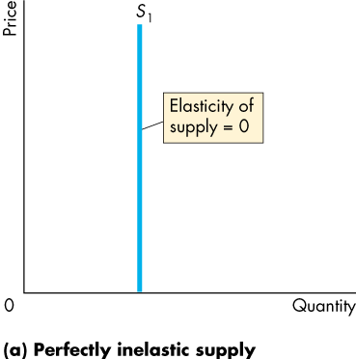
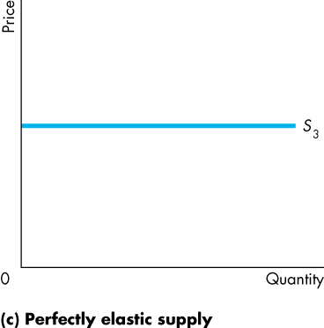
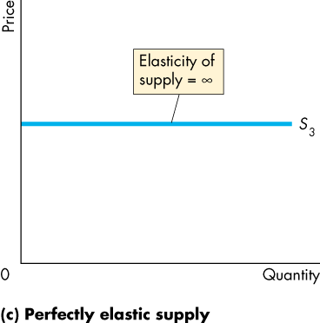
Elasticity of Supply
Change in Supply is same as change in price
Supply changes infinitely with a change in price
Supply does not change with change in price
Notes:
The unit elastic demand curve is a good one to use to emphasize that elasticity and slope are not equal. Have the students calculate the elasticity of supply on two linear demand curves that passes through the origin, one with a slope of 0.5 and the other with a slope of 2. They’ll get the message.

Slide 11
Determinants of Elasticity of Supply
Industries operating below full capacity
If there are unemployed resources and factors of production can be quickly engaged to increase Supply if quantity demand increases, then supply is elastic and vice Versa.
If stocks held are large
If large stocks are held or stored, supply is elastic. However when stocks have been used up it becomes inelastic.
Time factor
The supply of some products maybe inelastic in the short run such as the mining industry. It may become elastic in the long run. Supply is price inelastic in the short run because it can only be increased by increasing the variable factors.
Supply of most goods will be inelastic at any one moment (immediately)
Agricultural products
In the short run supply for agricultural products is inelastic. It may be elastic in the long run by which time the plants may have grown. Similarly supply maybe in elastic in an off-season for a plant.
Some plants however take a very long time to grow such as rubber, coffee Etcetera so even in the long run the supply maybe in elastic

Slide 12
Importance of Elasticity of Supply
If the Demand increases, a firm will know if it can meet the increased demand with/without changing prices
  If Supply is Elastic → Demand is met without increasing price.
  If Supply is Inelastic → Demand is met only with a sharp increase in price.

Slide 13
ELASTICITY OF DEMAND & TOTAL REVENUE
TOTAL REVENUE = PRICE X QUANTITY
Total Revenue = Consumer expenditure
Perfectly Inelastic demand
Simply increase price to increase Total Revenue
Perfectly Elastic demand
If price is increased, Profit will decrease and if price is increased, the consumer will shift to another product, so to increase Total revenue, the producer should simply increase supply
Unitary Elasticity Since a change in price brings about a proportionate change in quantity, Total Revenue can be simply increased by increasing advertising.

Slide 14
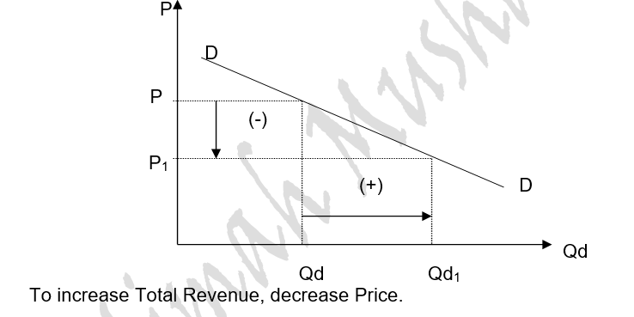
ELASTICITY OF DEMAND & TOTAL REVENUE – ELASTIC DEMAND

Slide 15
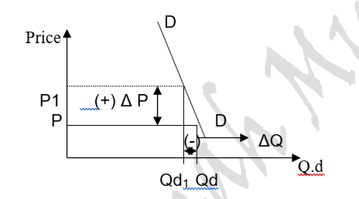
ELASTICITY OF DEMAND & TOTAL REVENUE – INELASTIC DEMAND
Increase Price to increase TR

Slide 16
THE USEFULNESS OF PRICE ELASTICITY FOR PRODUCERS
Firms can use price elasticity of demand (PED) estimates to predict:
The effect of a change in price on the total revenue & expenditure on a product.
The likely price volatility in a market following unexpected changes in supply – this is important for commodity producers who may suffer big price movements from time to time.
The effect of a change in a government indirect tax on price and quantity demanded and also whether the business is able to pass on some or all of the tax onto the consumer.
Information on the price elasticity of demand can be used by a business as part of a policy of price discrimination (also known as yield management). This is where a monopoly supplier decides to charge different prices for the same product to different segments of the market e.g. peak and off peak rail travel or yield management by many of our domestic and international airlines.

Slide 17
OTHER MEASURES OF ELASTICITY OF DEMAND
CROSS ELASTICITY OF DEMAND
INCOME ELASTCITY OF DEMAND

Slide 18
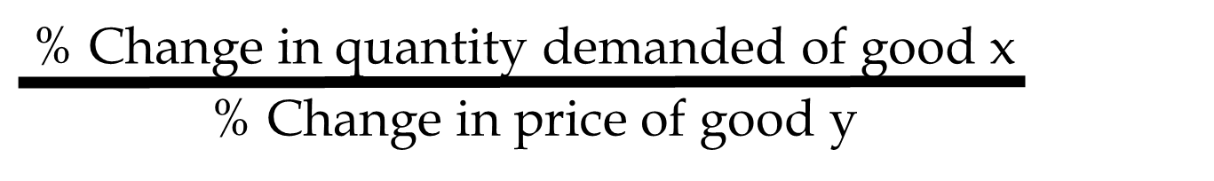
Cross Elasticity of Demand
This measures how responsive is Qd to changes in price of other goods, i.e. if the price of good Y rises, how will it affect the Qd of good X.
It is useful in finding out whether the goods are substitutes or complements

Slide 19
CROSS ELASTICITY OF DEMAND - SUBSTITUTES
.
Two goods that are substitutes have a positive cross elasticity of demand: as the price of good Y rises, the demand for good X rises
Example, price of Butter increases, demand of Margarine increases
The cross elasticity of substitute is positive and the higher the positive value, the closer the substitutes.

Slide 20
CROSS ELASTICITY OF DEMAND – COMPLEMENTS
Two goods that complement each other show a negative cross elasticity of demand: as the price of good Y rises, the demand for good X falls
Example the Price of Cell Phone increases, the Demand of Sims decreases.
The cross elasticity of complements is negative and the lower the negative value, the closer the complements.

Slide 21
CROSS ELASTICITY OF DEMAND – INDEPENDENT GOODS
A zero or near-zero cross elasticity
The two products being considered are unrelated or independent goods.
An example is walnuts and plums

Slide 22
Cross Elasticity
Substitutes Complements
Qx
Qx
Py
Py

Slide 23

Income Elasticity of Demand
Income is an important determinant of consumer demand, and YED shows precisely the extent to which changes in income lead to changes in demand. YED can be calculated using the following equation:

Slide 24
Income Elasticity of Demand
Normal goods: As income increases, so does Qd, so Income Elasticity of Demand is positive
Inferior goods: As income increases, Qd decreases, so Income Elasticity of Demand is negative
Helps producers decide whether to increase production or not
Industries producing products for which demand is income-elastic have expanded their outputs.
Industries producing products for which income elasticity is low or negative have tended to grow less rapidly or to decline
Income elasticity of demand for food is relatively low, while for luxuries is high.

Slide 25
Income Elasticity
Normal Inferior
Income
Income
Quantity
Quantity

Slide 26
SUMMARY
Elasticity of Supply
  Definition
  Formula
  Interpretation
  Importance
  Determinants
  Diagrams
Cross Elasticity
  Substitutes
  Complements
  Independent goods
Income Elasticity

